Slide 1
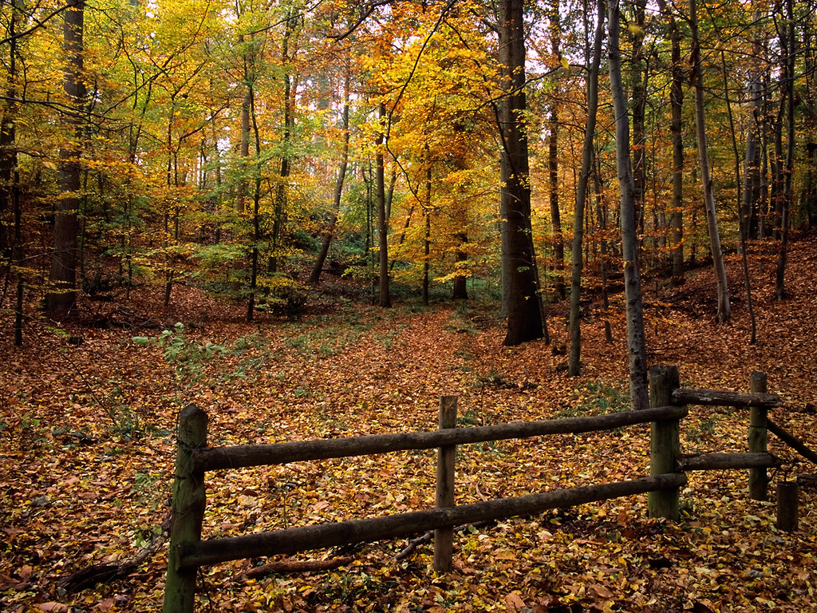
Nature Prayers

Slide 2
You can say a prayer in many different ways.
Prayers are not only said in the hall for Collective Worship or before leaving the school day.
There are many different ways to pray and speak to God. Over the next few RE lessons you will be able to explore prayer and how to become more spiritual through practical and creative ways.
However, you do not need to say prayers to God if you do not want to. You can spend a small amount of time in the day to be still, reflective, thinking of others or the things you are grateful for in your life. You can use these prayer ideas as stimulus.

Slide 3
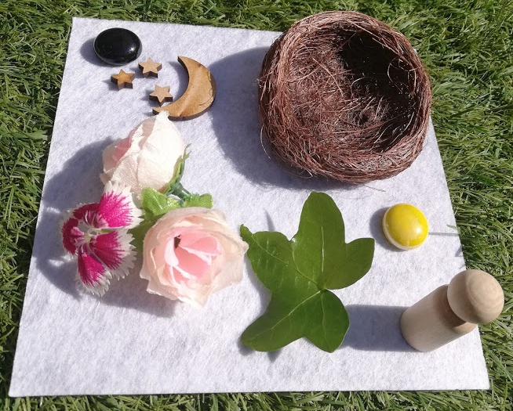
Nature prayers are really fun especially at this time of the year.
Go on a walk with a bag and collect examples of things you think are wonderful in the world.
(Don’t take flowers off plants unless you have permission!)

Slide 4
This time of year you could choose a single colour and explore the wonderful shades in God’s world.
Or you could choose a single theme like leaves and explore the shape and sizes.

Slide 5
Or you could choose flowers and explore the colour and types.
Just remember this is God’s world so maybe you could draw them or take a photo rather than pick them.

Slide 6
When you return home, lay them out in front of you.
Pray and say thank you to God for all of his beautiful designs from the veins on a leaf to the gentleness of a flower petal.

Slide 7
Praise and give thanks.
Praise and see His blessings.
Praise and listen to nature’s symphony.
Praise and love what gifts He has given you.

